Slide 1
GP HW11 (CH 14)
Solution

Slide 2
HW14-1 Problem 20-41 and 20-50 in Giancoli (pp. 554)
41.(a) An ice cube of mass m at 0°C is placed in a large 20°C room. Heat flows (from the room to the ice cube) such that the ice cube melts and the liquid water warms to 20°C. The room is so large that its temperature remains nearly 20°C at all times. Calculate the change in entropy for the (water + room) system due to this process. Will this process occur naturally? (b) A mass m of liquid water at 20°C is placed in a large 20°C room. Heat flows (from the water to the room) such that the liquid water cools to 0°C and then freezes into a 0°C ice cube. The room is so large that its temperature remains 20°C at all times. Calculate the change in entropy for the (water + room) system due to this process. Will this process occur naturally?
Sol:
(a) This process will occur naturally.
Assume the mass m is in kg

Slide 3
(b) This process will NOT occur naturally.
50. The specific heat per mole of potassium at low temperatures is given by where and Determine (by integration) the entropy change of 0.15 mol of potassium when its temperature is lowered from 3.0 K to 1.0 K.
Sol:

Slide 4
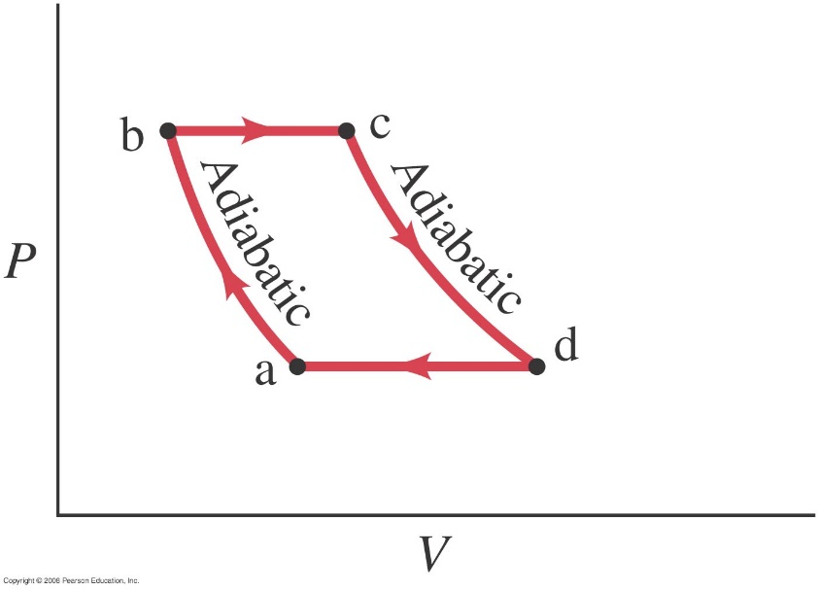
HW14-2 Problem 20-78 in Giancoli (pp. 557)
A gas turbine operates under the Brayton cycle, which is depicted in the PV diagram of Fig. 20–28. In process ab the air-fuel mixture undergoes an adiabatic compression. This is followed, in process bc, with an isobaric (constant pressure) heating, by combustion. Process cd is an adiabatic expansion with expulsion of the products to the atmosphere. The return step, da, takes place at constant pressure. If the working gas behaves like an ideal gas, show that the efficiency of the Brayton cycle is
Sol:

Slide 5
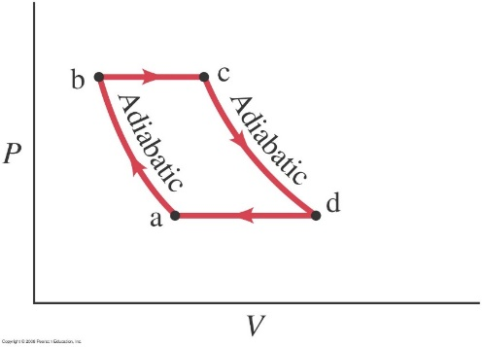

Slide 6
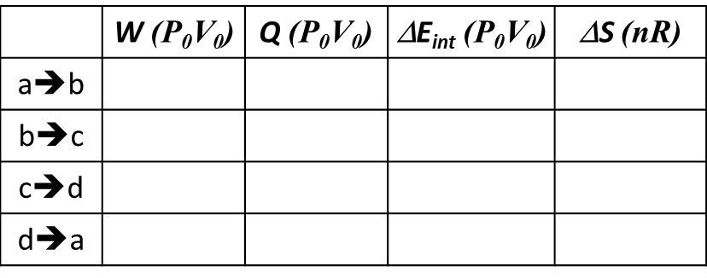
HW14-3
Figure shows the cyclic process that an ideal gas thermal engine execute: a→b and c→d are isovolumetric processes, b→c and d→a are adiabatic processes, assume γ=5/3 for the gas in the engine, determine the value in the table and the efficiency of this engine.
P
64P₀
b
adiabatic
32P₀
a
c
d
V
V₀
8V₀

Slide 7
Sol:
a | 32 | 1 | 32
b | 64 | 1 | 64
c | 2 | 8 | 16
d | 1 | 8 | 8

Slide 8
P
b
64P₀
adiabatic
32P₀
a
c
d
V₀
8V₀
V
a→b
b→c
c→d
d→a

